Slide 1
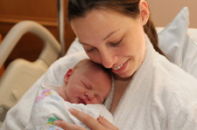
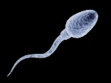
How can we protect ourselves against unsafe sex?
Put the storyboard in the correct order.
Then choose to complete either the Level E challenge,
or the Level D mega challenge.
A) A man and a woman who have sexual feelings for each other find that when they spend time together their bodies act in different ways. | B) The sperm buries itself into the egg and together they create an embryo. This will grow into a baby. The sperm and the egg have carried genetic information about what the new baby will be like, e.g. if both parents have black hair, it’s very likely the new baby will too. | C) After nine months of it growing inside her, the woman then pushes the baby out of her vagina and ‘gives birth’ to it.
D) The sperm which looks like this: will then swim inside the woman’s fallopian tube until it meets an egg which looks like this: | E) The man then puts his penis into the woman’s vagina and moves it in and out a lot. This gives both people sexual pleasure. At the height of this pleasure, a substance called ‘sperm’ will come out of the man’s penis and into the woman’s vagina. | F) As the woman’s body prepares for sexual intercourse, her vagina gets wetter to make it easier for the man to put his penis in. The man’s penis gets harder, so it is easier to insert into the woman’s vagina.

Slide 2
How can we protect ourselves against unsafe sex?
Key words –
STIs – Sexually transmitted infections (diseases and illnesses caught by people who have unsafe sex).
Contraceptives – things you can use to stop getting pregnant and also prevent catching STIs
Level F – Describe some ways we can protect ourselves against unsafe sex.
Level E – Explain the pro’s and con’s of particular forms of contraceptives and where the best place would be for a teenager to get advice and contraception.
Level D – Analyse where the incorrect myths about sex might come from and evaluate which type of contraception is best depending on a person’s circumstances.

Slide 3
Places you can get advice on myths people have about sex
contraception
http://www.bbc.co.uk/schools/pshe_and_citizenship/personal_wellbeing/healthy_lifestyles/sexual_health/pages/teenage_pressures_contraception.shtml
Level E – Where would the best place be for a teenager to get advice on contraception and why?
Level D – Where do these myths about sex start and why are they so dangerous?

Slide 4
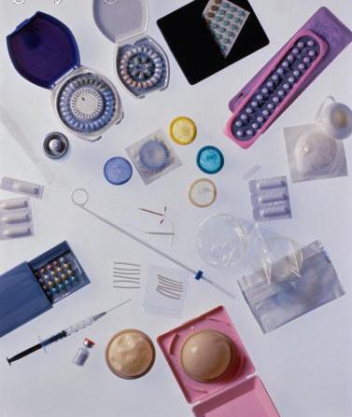
There are descriptions of different contraception methods around the room and pictures of them.
Complete your table starting at either challenging, more challenging or super challenging and sketch a drawing of each type of contraception. You can then feedback to the people who did different ones to you.
When you return to your seats your teacher will show you some real-life examples of the types of contraception we have been learning about.

Slide 5
How can we protect ourselves against unsafe sex?
Key words –
STIs – Sexually transmitted infections (diseases and illnesses caught by people who have unsafe sex).
Contraceptives – things you can use to stop getting pregnant and also prevent catching STIs
Level F – Describe some ways we can protect ourselves against unsafe sex.
Level E – Explain the pro’s and con’s of particular forms of contraceptives and where the best place would be for a teenager to get advice and contraception.
Level D – Analyse where the incorrect myths about sex might come from and evaluate which type of contraception is best depending on a person’s circumstances.

Slide 6
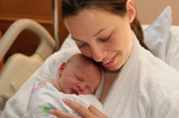
Plenary
Pieces of advice –
What three pieces of advices would you give a teenager who was planning on having sex for the first time?

