Slide 1
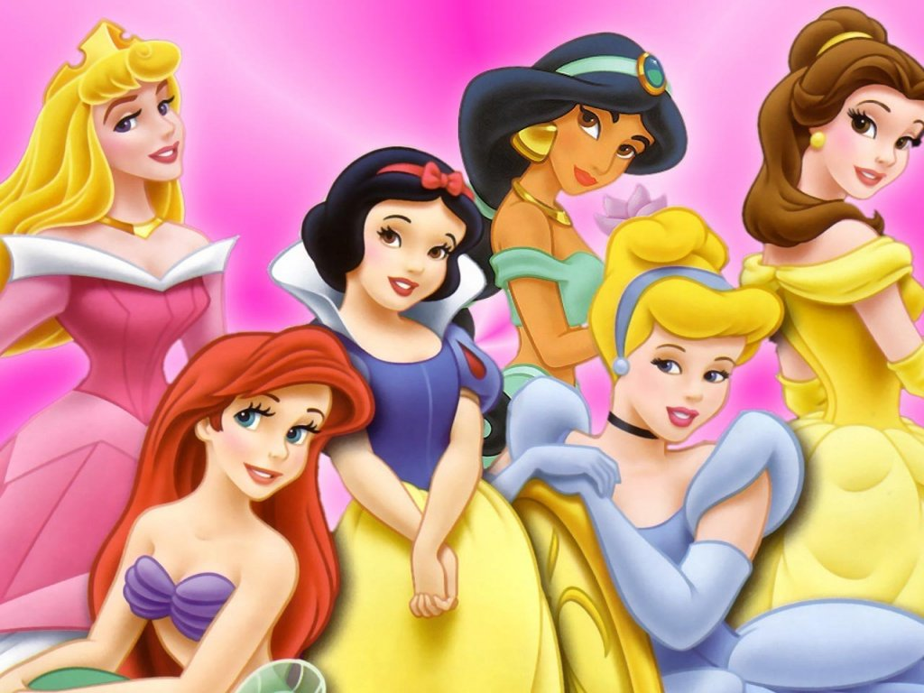
......

Slide 2
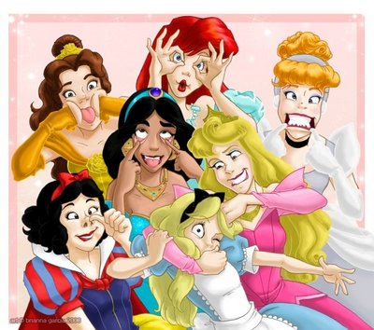
Not quite what it seems....

Slide 3
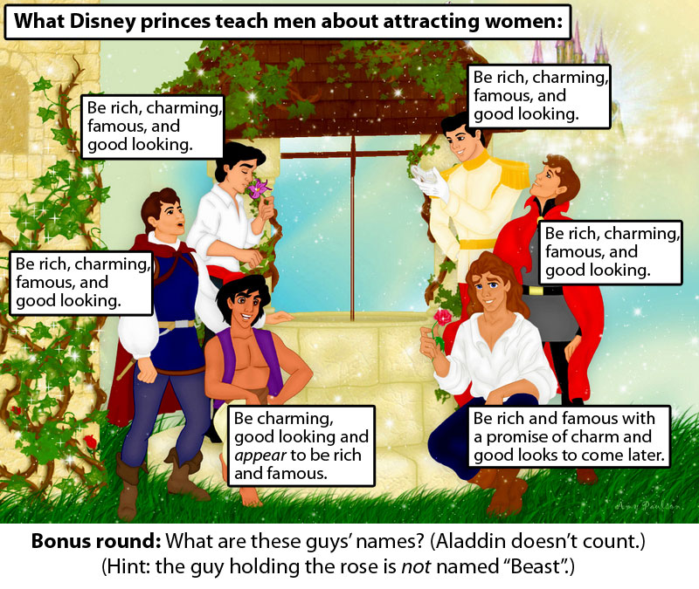
WALT
To consider and debate whether Disney promotes racial stereotypes.
To design our own positive Disney character and storyboard.

Slide 4
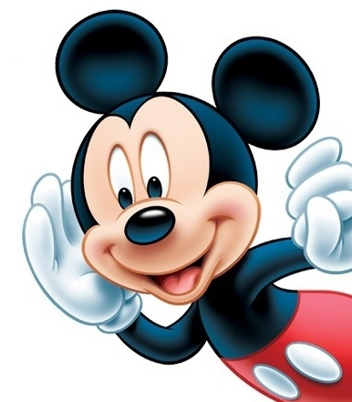
Why does Disney get so much criticism?
Disney has been heavily criticised for many different reasons based around the stories and characters they portray.
Disney is often criticised for the sexist nature of their films.............

Slide 5
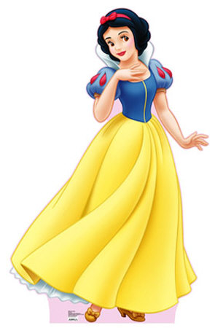
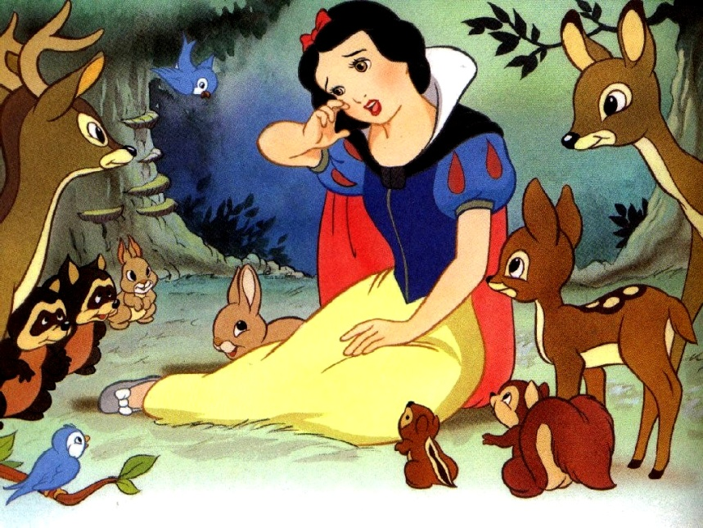
Snow White
Snow White was the heroine of the first full-length animated film, Snow White and the Seven Dwarfs, in 1937. Snow White is young, pretty, virginal, sweet-natured and obedient. She doesn't mind housework because she is sure that a rich young man will soon come and take her away.
When Snow White is afraid, she runs away and falls down in tears. When she finds shelter in a dirty little house in the woods, she immediately cleans it from top to bottom. When she lives there, she continues to do the housework: the group of (small) working males who live in the house clearly need a 'mother' to clean for them, so this is Snow White's natural role.
This is typical of Disney's movies. Young women are naturally happy home-makers; they wait (like Snow White in her coma) until a man comes along to give them life.

Slide 6
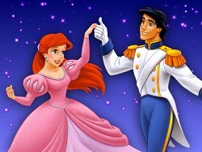
The Little Mermaid
It seems that Disney did not pay much attention to the Women's Movement: Ariel is the same as the earlier Disney heroines, except that she is somewhat sexy and wears a bikini made from shells. And the answer to all her dreams is to get her man. Ariel will do anything to make the prince fall in love with her. She even gives up her voice so that she can have legs
So Ariel gets her voice back and she keeps her prince. On the other hand, she loses everything else. When she becomes human and marries the prince, she must leave behind her underwater home, her father and her friends. She gives up everything in her life
So the message to young girls- Keep quiet, give up everything for a man and be beautiful

Slide 7
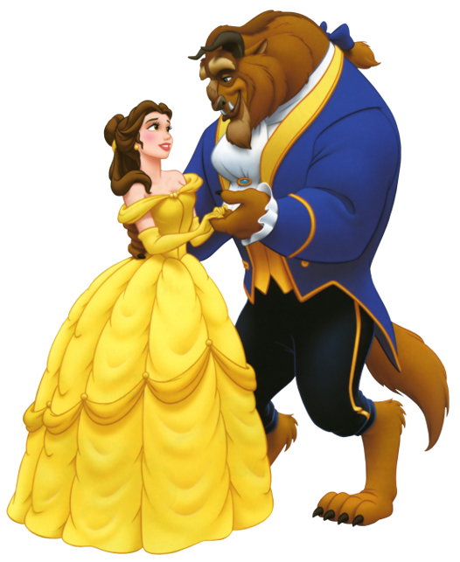
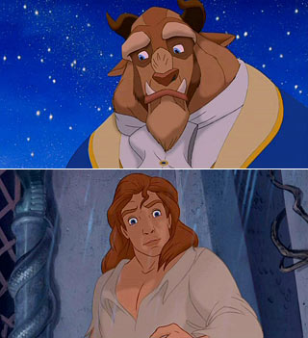
Beauty and the Beast
The company decided to create a Beast with a 'very serious problem'. Disney's Beast terrifies his household and frightens Belle, his prisoner. The Beast does not attack Belle, but the threat of physical violence is present.
In the Disney movie, Belle changes the character of the Beast. Her beauty and her sweet nature change him from a beast into a prince, from someone who is cruel, into someone who is kind.
The movie says, if a young woman is pretty and sweet-natured, she can change an abusive man into a kind and gentle man. In other words, it is a woman's fault if her man abuses her.
And of course the beast turns into a handsome prince because ugly people cannot be happy

Slide 8
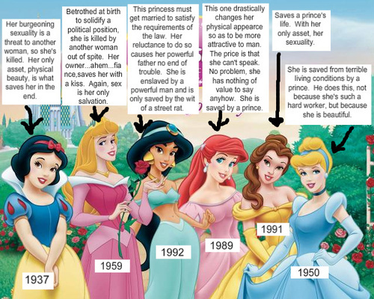

Slide 9
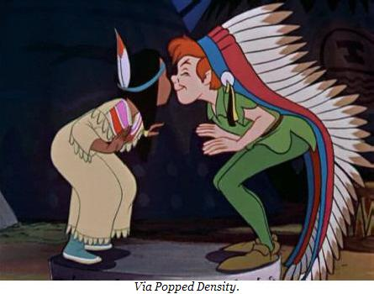
But what about racism?
Even though Disney is heavily criticised due to its gender stereotypes it also comes under attack due to its portrayal of ethnic minorities.
However some would argue that Disney is not racist it simply has to show ethnic minorities in a certain way to make small children understand different characters and offence caused is not intentional.
What do you think? Watch the following clip and think about your own views.

Slide 10
What’s your reaction?
Whether Disney promotes racist ideas is debatable.
I will show you some pictures from Disney films or products.
On your white board you must write if you think it is racist and why.

Slide 11
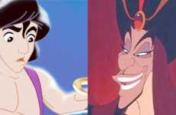

Slide 12
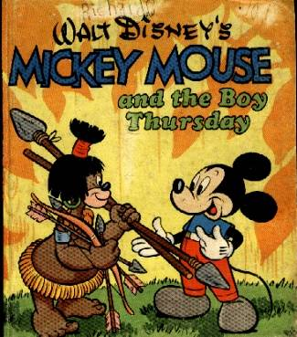
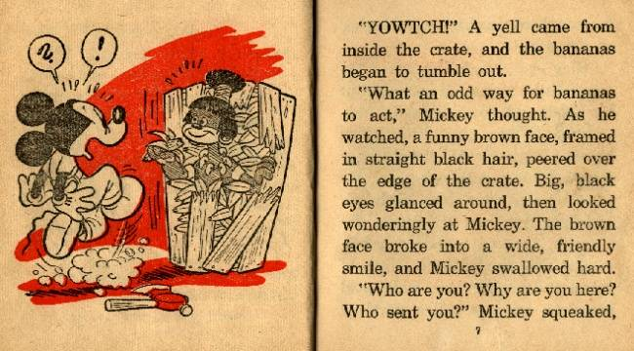
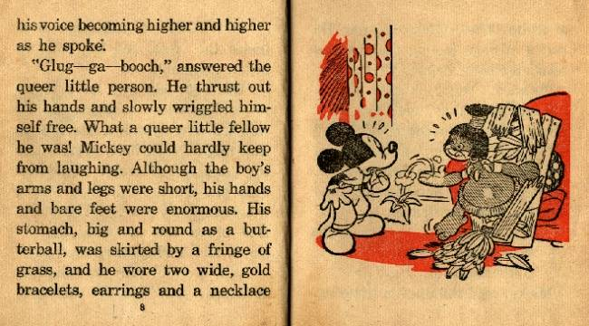
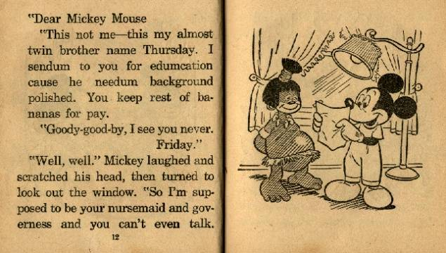

Slide 13
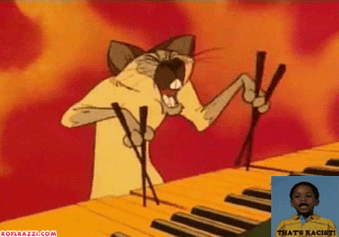

Slide 14
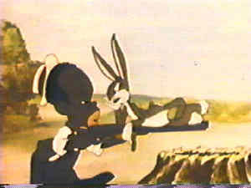

Slide 15
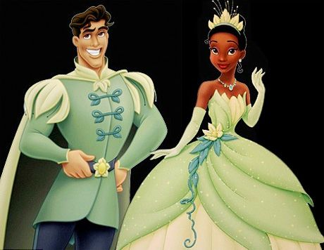

Slide 16
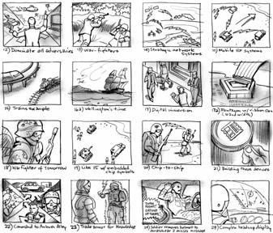
Disney Storyboard
You must now try to create a Disney film that promotes a positive message about diversity.
You must create a storyboard that outlines the story and the characters.
Think about a how your story can still be a Disney film but with a positive message

