Slide 1
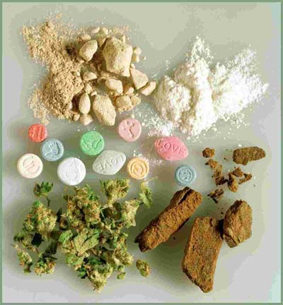
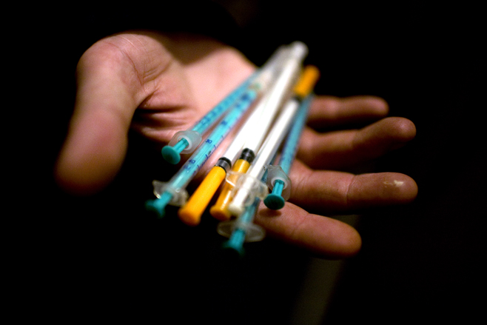
Year 7 – PSHE
Topic 9 Effects of Drugs

Slide 2
Learning Question
What are the harmful effects of drugs?

Slide 3
What are drugs?
Starter
Make a list of all the different drugs you can
think of.
What do they all have in common?
What are drugs?

Slide 4
What is a drug?
…any substance which causes a change in the way the body, or part of the body, works.

Slide 5
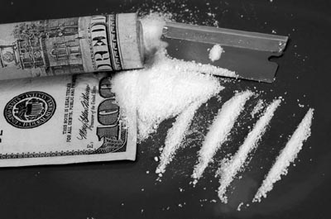
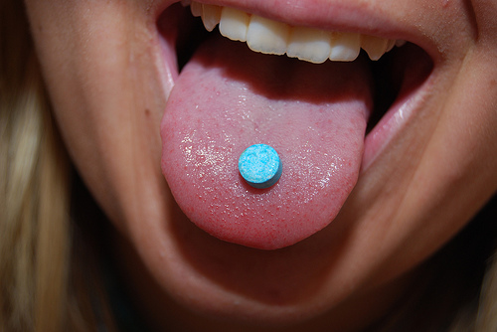
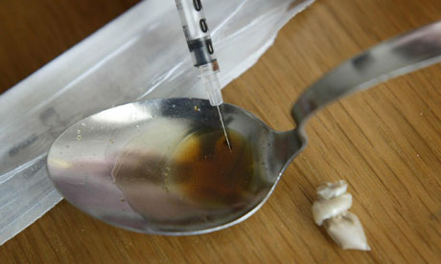
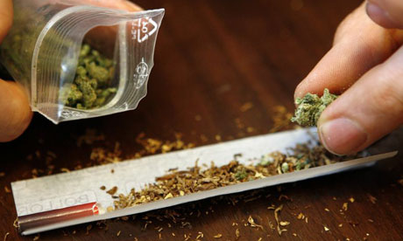
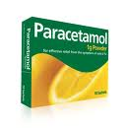
NAME THAT DRUG

Slide 6
Activity
Discuss what you think the effects of a Class A drug would be.
In your opinion what might a Class C drug be like?

Slide 7
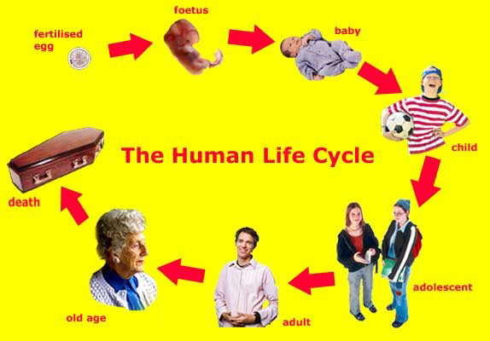
Discuss how drugs might affect people at each stage of the human lifecycle
Activity 2

Slide 8
Activity 3
In groups of 3 complete the worksheet – who do drugs affect?

Slide 9
Your task, in groups of 3 or 4
Is to decide on a question you wish to debate
In your groups you must write a script debating the question you have decided on!
You need to have two contrasting views about the question you are debating, for example one person for and one against!
The script must last for around two minutes-
Good Luck!
Activity 4

Slide 10
Consider the issues….
http://www.tes.co.uk/teaching-resource/KS3-4-PSHE-Drugs-Breaking-the-Habit-6044030/

Slide 11
Activity 4 –
Possible Debate Topics
What are the dangers of legal highs?
Alcohol kills more people each year than any illegal drugs, what should be done to tackle this social problem?
How can drugs education be improved in schools?
Do you think drug abusers should receive NHS treatment and support, free of charge?
Cannabis has been changed from a class B to a C drug. What do you think the law on this drug should be and why?
What are the real reasons behind young people and illegal substance abuse?
What are the effects of drug abuse on society?

Slide 12
Activity 5 – Design a Poster
Design a poster to warn people about the dangers of drug taking and how it could effect your life
Include some images.

Slide 13
Plenary 3-2-1
Bullet three things that you knew about drugs that were confirmed this lesson
Bullet point two things that you learnt about drugs from today’s lesson
Write down one question that you could ask to help you research and find out more about drugs.

